Slide 1



ABAP on Hana s/4 Hana Training
Day 20
contact@anubhavtrainings.com

Slide 2

Agenda – Day 20
What is Analytic List Page ( ALP )
Usage of ALP
CDS View’s for ALP
Create Analytic List Page on BAS
S/4HANA End to End PoC of ALV IDA ( Integrated Data Access )
Implementing ALV
Q & A
Trainer: Anubhav Oberoy & Shubham Singh

Slide 3
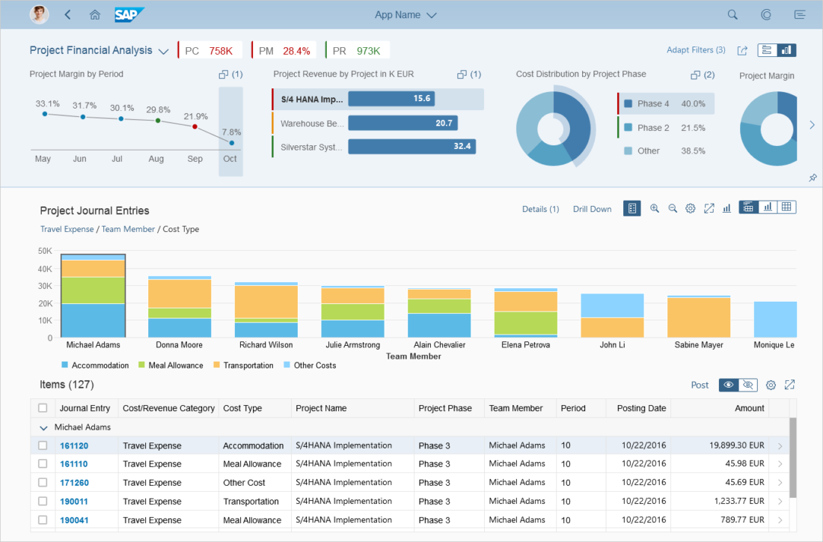
What is Analytic List Page ( ALP )
The analytical list page (ALP) offers a unique way to analyze data step by step from different perspectives, to investigate a root cause through drilldown, and to act on transactional content. All this can be done seamlessly within one page. The purpose of the analytical list page is to identify interesting areas within datasets or significant single instances using data visualization and business intelligence.
Trainer: Anubhav Oberoy & Shubham Singh

Slide 4
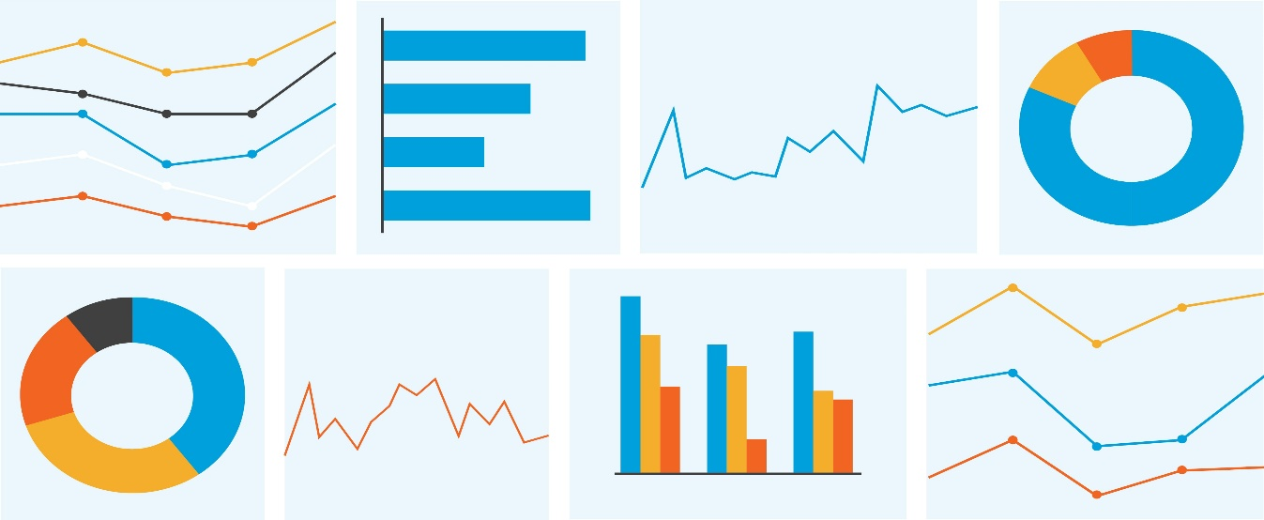
Use the Analytic List Page if
The purpose of the analytical list page is to identify interesting areas within datasets or significant single instances using data visualization and business intelligence. ... Chart visualization increases the joy of use, and enables users to spot relevant data more quickly.
Users need to extract key information to understand the current situation or identify a root cause.
The way the data is presented is crucial for giving them the insights they need to take the right action.
Users need a way to analyze data step by step from different perspectives, investigate a root cause through drilldown, and act on transactional content within one page.
In addition to the filtered dataset, users need to see the impact of their filter settings in a chart (visual filter).
Users need to switch between integrated chart and table views (hybrid view).
Users need to see the impact of their action on a global key performance indicator (KPI).
Users need to find and act on relevant items out of a large set of items by searching, filtering, sorting, grouping, drilling down, and slicing and dicing.
Trainer: Anubhav Oberoy & Shubham Singh

Slide 5
Do not use the Analytic List Page if
Drilldown is rarely used, not used at all, or is only needed after navigating to another page, rather than as free or flexible drilldown within the page itself. In this case, a list report might be sufficient for your use case.
Users need different visualizations for the entire dataset (for example, as a table or chart), but don’t need to work with both visualizations on the same page (for example, in a reporting scenario). In this case, a list report might be sufficient.
Users need to find and act on relevant items from within a large set of items by searching, filtering, sorting, and grouping, without using drilldown or “slice and dice”. In this case, consider using a list report.
Users need to work with multiple views of the same content, for example on items that are “Open”, “In Process”, or “Completed”. They want to be able to switch views using tabs, segmented buttons, or a select control. In this case, consider using a list report.
Users need to see or edit a single item with all its details. Use the object page floorplan instead.
Users need to find a specific item, and the item or an identifying data point is known to the user (such as a code). In this case, use the initial page floorplan.
Users need to work through a comparably small set of items, one by one. In this case, use the worklist floorplan.
Users have a trivial use case that does require the use of a chart, but that do not involve identifying a root cause, analyzing data, or drilldown. Instead, use a list report with a table/chart switch.
Trainer: Anubhav Oberoy & Shubham Singh

Slide 6
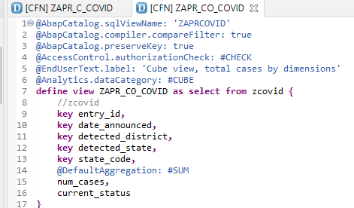
Create CDS View’s for Analytics
Create CDS View ZAPR_CO_COVID on top of table “ ZCOVID ”.
Use Analytic Annotation.
Use Aggregation Annotation.
Analytic Annotation
Aggregation Annotation
Trainer: Anubhav Oberoy & Shubham Singh

Slide 7
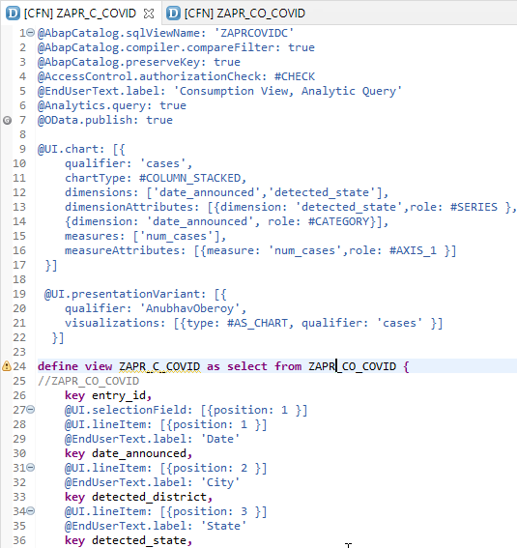
Consumption CDS View’s for ALP
Create Consumption CDS View ZAPR_C_COVID on top of Basic CDS View “ ZAPR_CO_COVID ”.
Use Annotations :
Analytic Annotation
OData Annotation
UI Chart Annotation
Trainer: Anubhav Oberoy & Shubham Singh

Slide 8
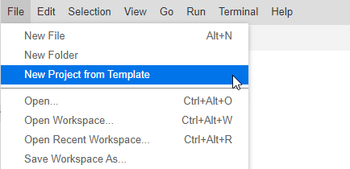
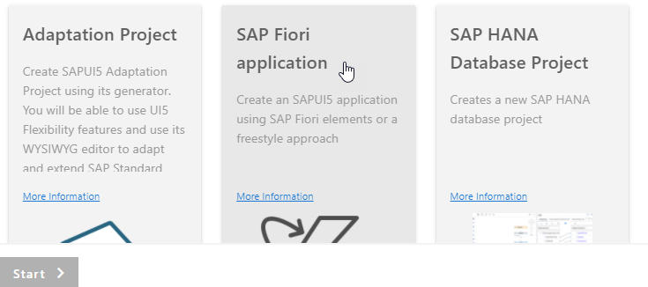
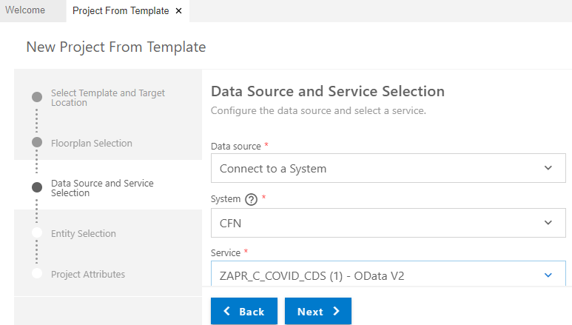
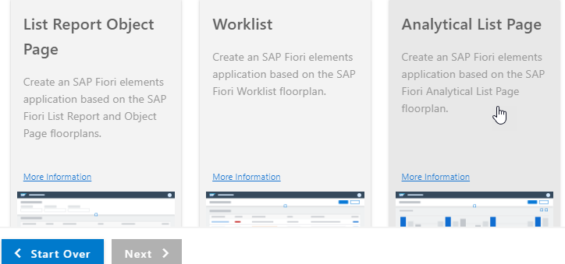
Create Analytic List Page using BAS
Step 1. Open Business Application Studio & Create Project from Template.
Step 2. Click On Fiori Application & Start.
Step 4. Enter Data Source Details & Next.
Step 3. Click On Analytical list page & Next.
Trainer: Anubhav Oberoy & Shubham Singh

Slide 9
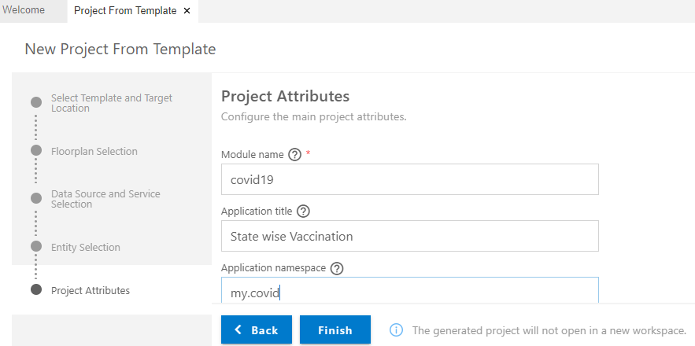
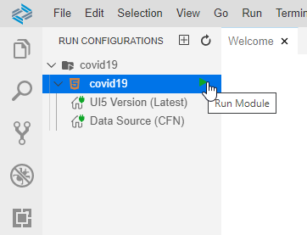
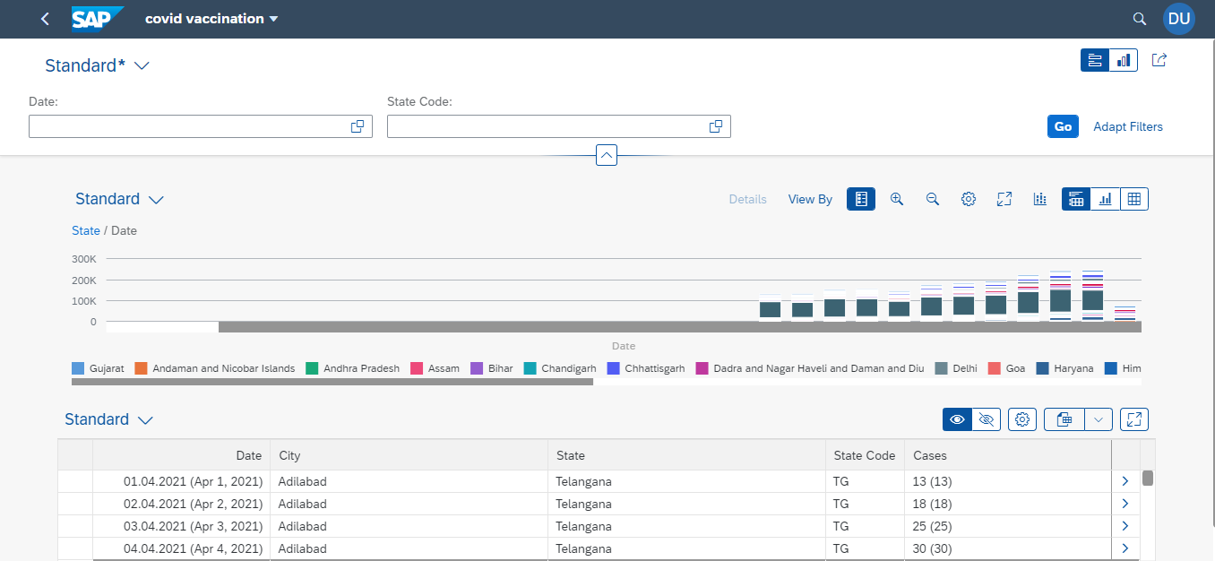
Create Analytic List Page using BAS
Step 5. Enter Project Attribute Details & Finish.
Step 6. Add Configuration and Run Project.
After Adding Annotation File Final Output of Analytic List Page
Trainer: Anubhav Oberoy & Shubham Singh

Slide 10

End to End ALV IDA ( Integrated Data Access )
Overview. ALV with IDA (SAP List Viewer with Integrated Data Access) helps tables that contain very large quantities of data to be displayed on the UI. ... It uses the in-memory database, such as SAP HANA, without having to switch to a new programming environment.
Trainer: Anubhav Oberoy & Shubham Singh

Slide 11
ALV with IDA Introduction
Most important changes / improvements:-
Real-time, regardless size of output table
Only VISIBLE rows are copied from Database
Every scroll is a „separate" SELECT statement
Data volume transferred from DB to application server is drastically reduced
Code-to-data paradigm (aka Code Pushdown)
Data intensive operations moved to database.
Tools: CDS View, HANA View (using SQL Jtf.ript)
Application layer divided into two areas:
Orchestration Logic - handles business processes
Calculation Logic - performs operations on data
Trainer: Anubhav Oberoy & Shubham Singh

Slide 12
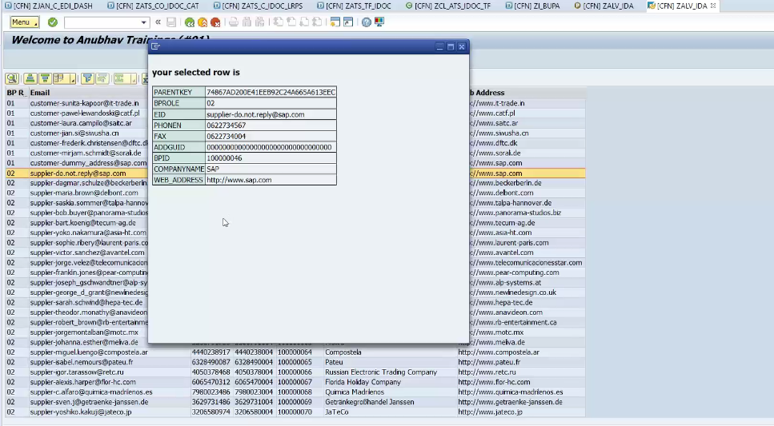
Implementing ALV IDA Integrated Data Access
Trainer: Anubhav Oberoy & Shubham Singh

Slide 13

Exercise
S/4HANA End to End PoC of ALV IDA Code
Trainer: Anubhav Oberoy & Shubham Singh

Slide 14

End of Day 20
Trainer: Anubhav Oberoy & Shubham Singh

Slide 15

Trainer: Anubhav Oberoy & Shubham Singh

Slide 16
THANK YOU
If you cannot do
great things, do small things in a great way.
Anubhav Oberoy & Shubham Singh
https://www.anubhavtrainings.com
Trainer: Anubhav Oberoy & Shubham Singh

Slide 17


We’re committed to empower you to be
Most Desirable Resource
through powerful training solutions.
We build the workforce of the future.
250+
Corporate Clients
30,000+
Learners Trained
25000+
Learners Placed
FREE WEBINARS
Sign up for free webinars with industry experts every fortnight!
Enroll Now!
Contact us today!
https://anubhavtrainings.com/

Slide 18




More from AnubhavTrainings.com

